Slide 1
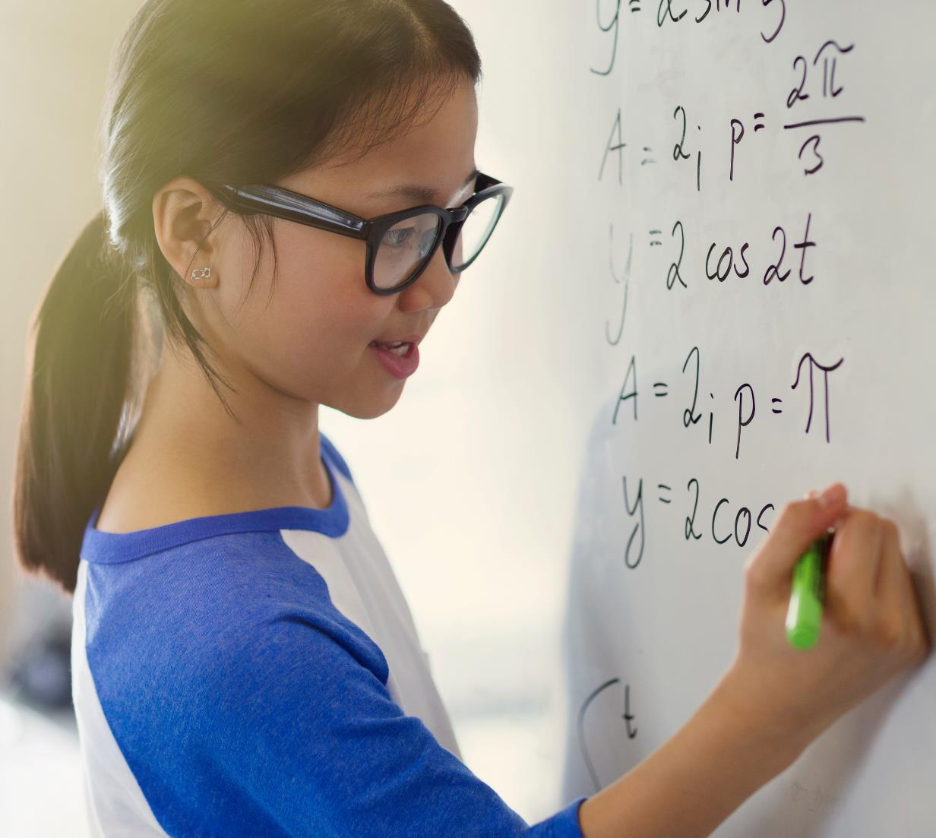
Programming Languages

Slide 2
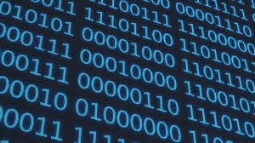
Computers
A computer understands 0 & 1 i.e. binary.

Slide 3
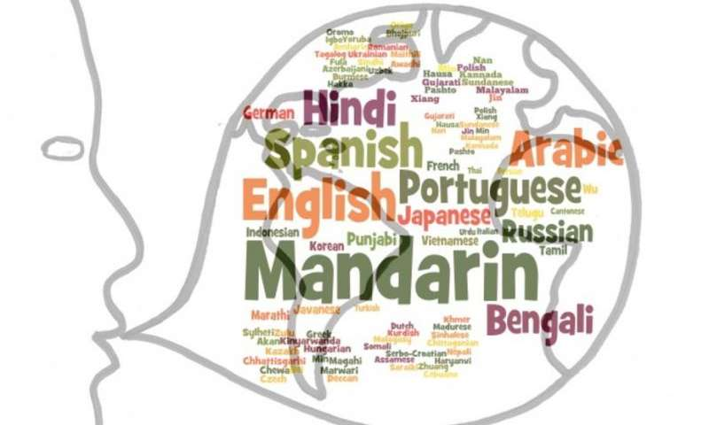
Humans
Humans understand and communicate in their own languages like Hindi, English,French etc.

Slide 4
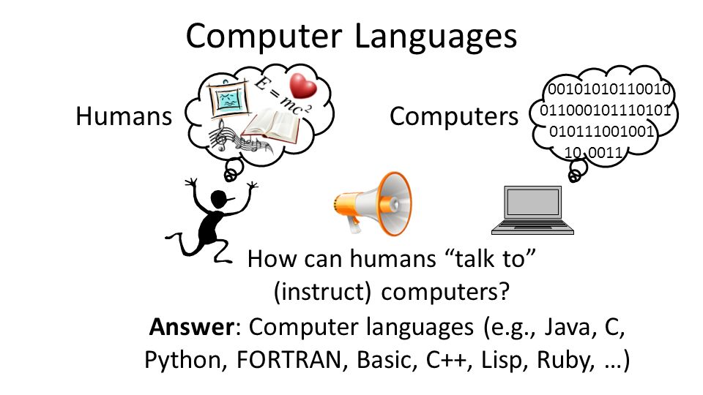
Programming Languages
In order for the humans to interact with the computer we need a programming language which both a computer and a human unserstand and are well versed with.

Slide 5

Questions ??

